Slide 1
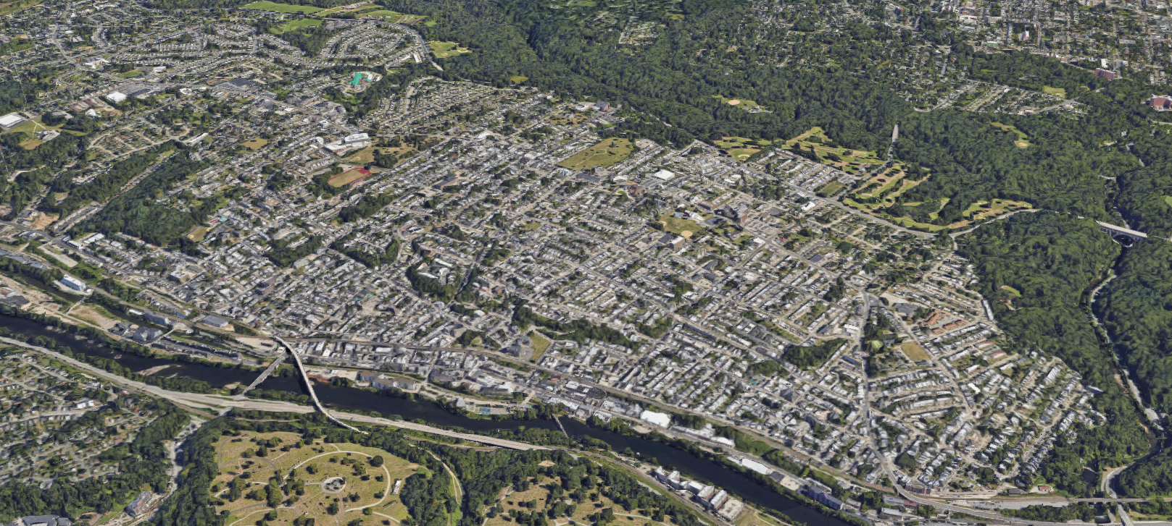
Ridge Avenue Neighborhoods Overlay
April 11, 2024
PCPC Staff:
Aaron Holly, PCPC
Jack Conviser, PCPC
Anthony Christinizio, PCPC
Madison Matera, PCPC
Amy Boyd, PCPC
Presented by Philadelphia City Planning Commission
Hosted by Neighborhood RCOs

Slide 2
TONIGHT’S AGENDA
Introduction
Presentation of Proposed Updates
Questions & Discussion

Slide 3
WHAT IS ZONING?
Everyone who owns land owns a set of rights that come with that land.
Credit: Bardo Law
Notes:
Everyone who buys a piece of property has certain rights that come with that property. These rights fit generally into your right to hold, rent, or sell property, and the right to develop within certain limits as determined through your property’s zoning.

Slide 4
WHAT IS ZONING?
Zoning protects communities with rules for
how land can be used and the
size and shape of new buildings
Notes:
Zoning not only protects your rights as a land owner, but zoning is also used to protect your rights as a neighbor. It can set limits on the types of uses and shapes and sizes that are allowed next door to you.

Slide 5
WHAT IS ZONING?
Zoning protects communities with rules for
how land can be used and the
size and shape of new buildings
ACME JACKHAMMER
SALES AND TESTING
Notes:
Zoning gives owners a reasonable expectation about how nearby property will be used. Without zoning, a neighbor might use property in a way that detracts from the peaceful enjoyment of your own home. For example, a jackhammer factory.

Slide 6
ACME JACKHAMMER
SALES AND TESTING
A-1 LIVE POULTRY
Notes:
Or a bulky tower, or, say, a slaughterhouse. Any of these land uses or sizes or shapes of buildings might have an impact on how nearby property could be used. That’s why most cities have rules about these things.

Slide 7
WHAT IS ZONING?
Zoning can regulate:
Use
Size
Shape
Zoning cannot regulate:
Construction Techniques
Rental vs. Homeownership
Trash
Crime
Property Management
Notes:
Generally, zoning can regulate the use, size, and shape of buildings.
What it cannot do is regulate construction techniques and materials, determine whether a property is rented or home-owner occupied, littering, trash, crime, or how a property is maintained.

Slide 8
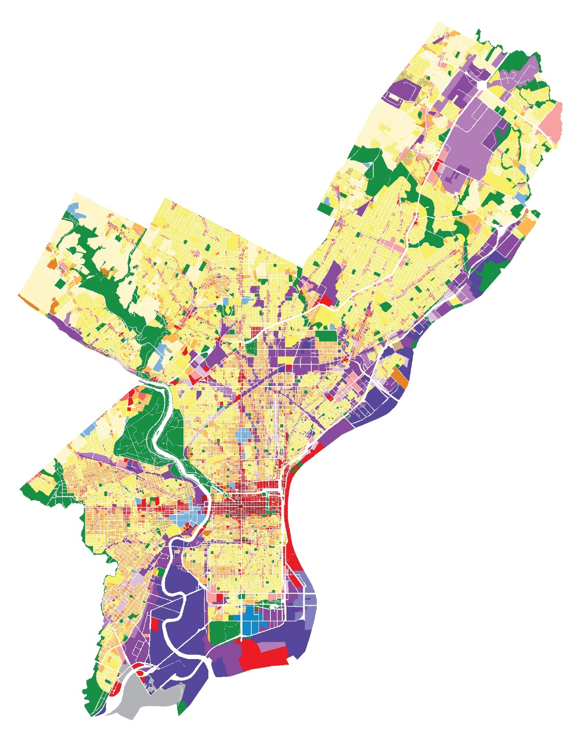
WHAT IS ZONING?
Zoning Districts
Commercial
Industrial
Residential
Open Space
Notes:
There are two parts to zoning. The first is a map that shows where each district is.
Philadelphia’s zoning is generally set up to separate uses and scales of uses (ex. Dense commercial in Center City, University City, and near industrial parks, Industrial along our rivers and in industrial parks, residential is clustered with neighborhood serving uses. These districts can get changed over time by City Council, but some of these zoning classifications haven’t been changed in years. But we’ll get back to that later.

Slide 9
ZONING OVERLAYS
Overlay zoning district regulations apply in combination with underlying base zoning district regulations.
When there is a conflict between the overlay and base zoning district, the regulations of the overlay zoning district govern.

Slide 10
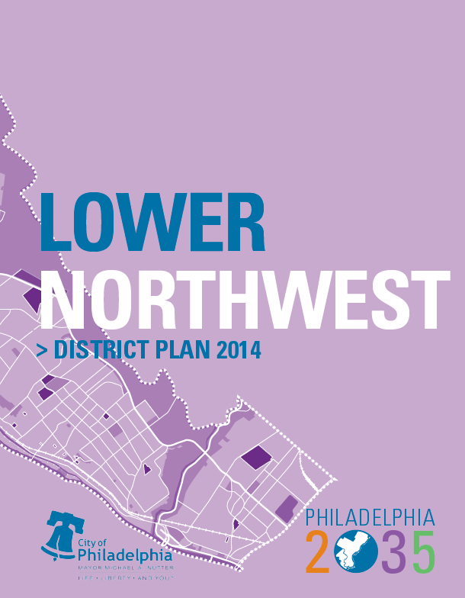
GOALS OF PROPOSED UPDATES
“Right Size” new development
Regulate multifamily residential properties
LNW 1: Update the Ridge Avenue zoning overlay to encourage new development that adheres to the community’s vision.

Slide 11
PROPOSED UPDATES - OVERVIEW
Shift location of the overlay in the zoning code
Contextual height limits along corridor
Limits on bulk and mass of large buildings
Other Updates
Property Remappings

Slide 12
PROPOSED UPDATES – OVERLAY LOCATION
Shift location of the overlay in the zoning code
Currently Ridge Avenue Neighborhood Commercial Area Overlay
Neighborhood Commercial Area Overlays (NCAs)
Preserve the integrity of neighborhood commercial areas
Promote and help guide appropriate commercial development
Does not apply to residential properties

Slide 13
PROPOSED UPDATES – OVERLAY LOCATION
Ridge Avenue Neighborhoods Overlay
Keeps commercial properties that were in NCA
Incorporates multifamily residential properties
Extends boundaries to Domino Ln.

Slide 14
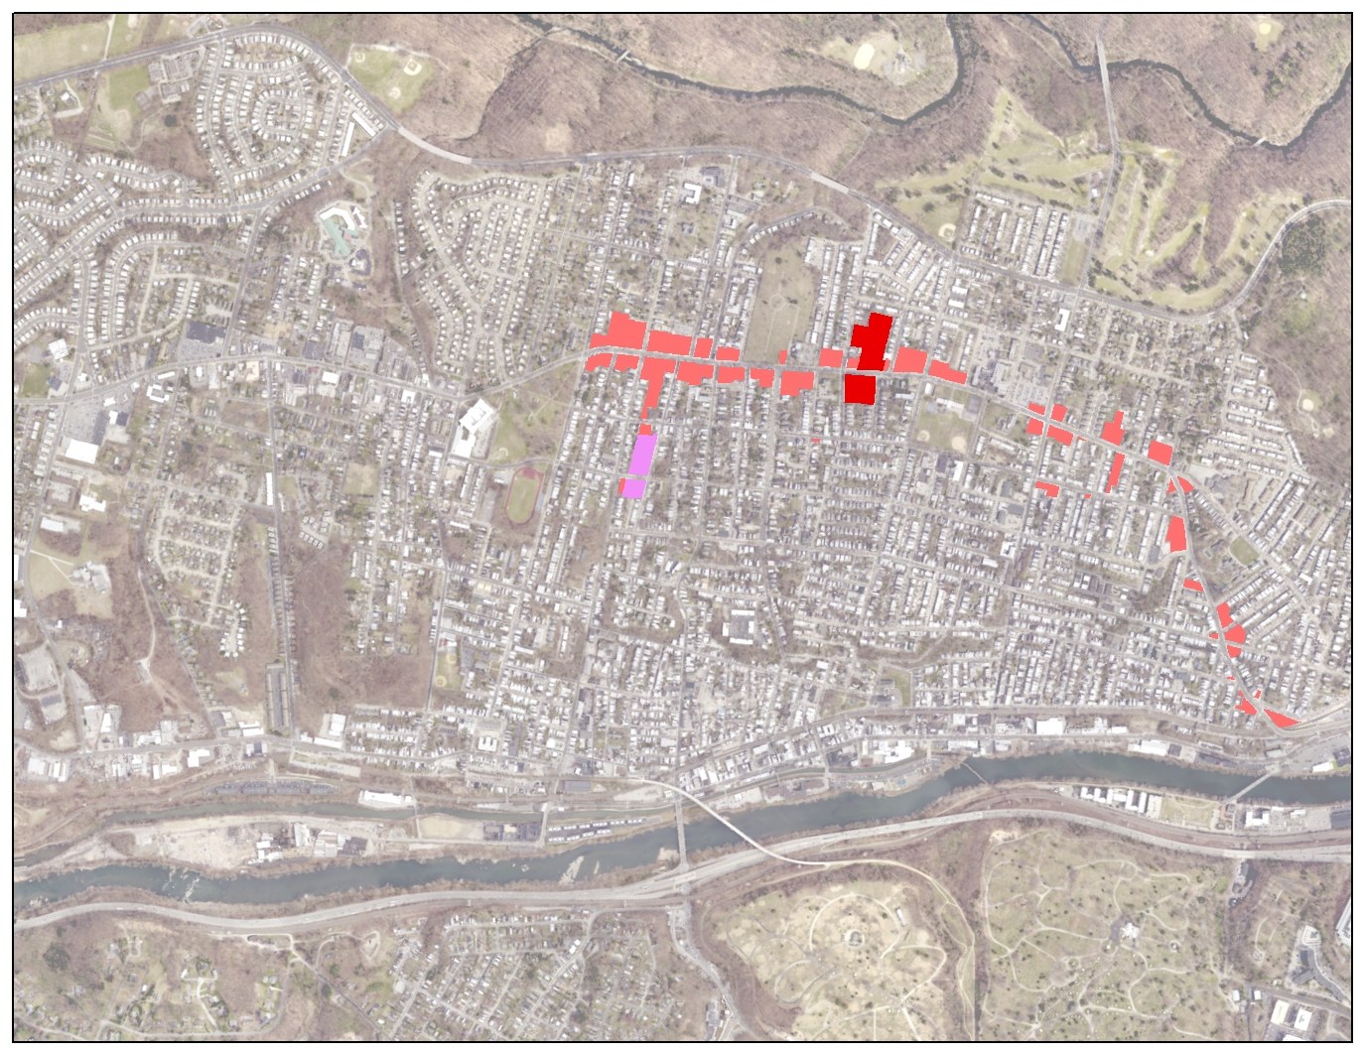
Current extent of overlay boundaries
RIDGE AVE
PAOLI AVE
LEVERINGTON AVE
SHURS LN
CRESSON ST
Current extent of overlay boundaries

Slide 15
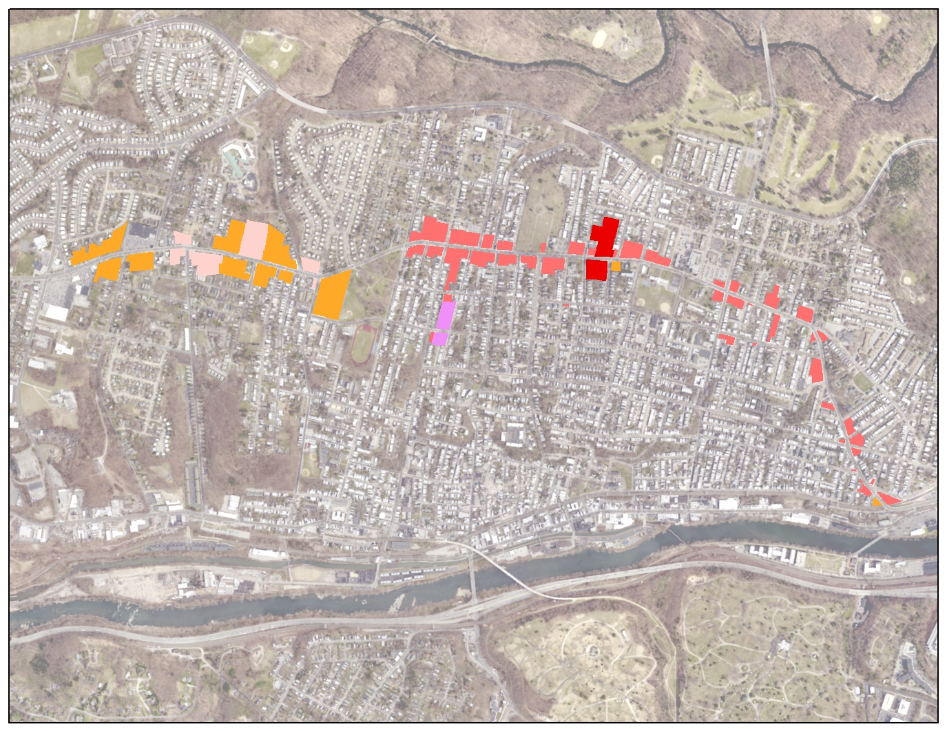
Proposed extent of overlay boundaries
RIDGE AVE
DOMINO LN
LEVERINGTON AVE
SHURS LN
CRESSON ST
Proposed extent of overlay boundaries

Slide 16
PROPSED UPDATES - HEIGHT
Height Requirements
Building height limited to 45 feet/4 stories
Between Leverington Avenue. and Shurs Lane.
Reduction from 55 feet
Building height limited to 38 feet/3 stories
Leverington Avenue to Domino Lane
Shurs Lane to Cresson Street
Minimum 14-foot floor to floor height for required commercial space.

Slide 17
38’ Height Limit
45’ Height Limit
38’ Height Limit
RIDGE AVE
DOMINO LN
LEVERINGTON AVE
SHURS LN
CRESSON ST

Slide 18
PROPSED UPDATES – BONUSES
Extra height permitted through providing affordable housing on site (Mixed Income Housing Bonus)
7 feet/1 story
No other height/density bonuses permitted.

Slide 19
PROPOSED UPDATES – BULK AND MASSING
Lots greater than 5,000 square feet.
Portions of a building within 20 feet of a residential single-family district cannot exceed 38 feet in height
Contextual setbacks on side streets
Required side yards when abutting residential single-family district
Required landscaped, front yard setbacks for RM-1properties

Slide 20
38 feet/3 stories
Domino Ln. to Leverington Ave. and Shurs Ln. to Cresson St.
CMX-2/RM-1

Slide 21
45 feet/4 stories
Leverington Ave. to Shurs Ln.
CMX-2.5

Slide 22
PROPOSED UPDATES - PARKING
Parking Updates
Removes off-site parking provision
Allows for parking to be in an underground garage
Keeping 1 parking space per unit (after the first five units)
Required on site affordable units are exempt from parking requirement

Slide 23
PROPOSED UPDATES - OTHER
Adds Art Commission review for signs
Multifamily (RM-1) properties subject to façade review and overlay regulations
Required screening for utility equipment
Changes to use regulations
Sales of telecommunications equipment now requires a special exception

Slide 24
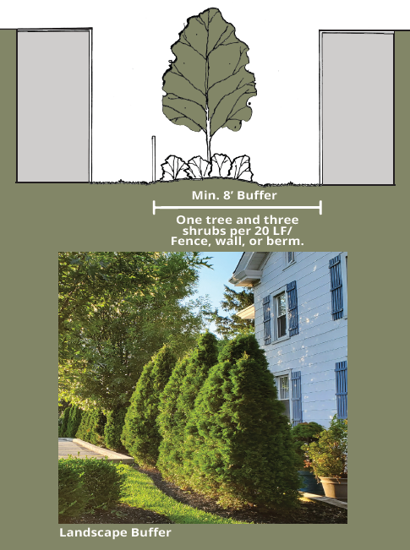
LANDSCAPE REQUIREMENTS
Required landscape buffers for projects abutting residential single family

Slide 25
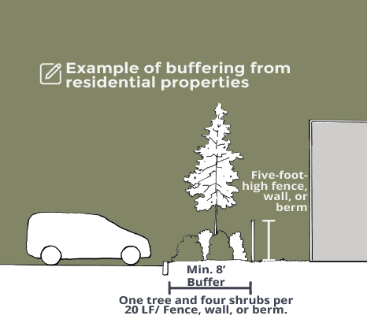
LANDSCAPE REQUIREMENTS
Required landscape buffers for parking lots abutting residential district

Slide 26
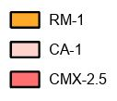
CURRENT ZONING

Slide 27
PROPOSED ZONING
Remap schools and city facilities to appropriate zoning
Remap other properties to align with desired height requirements

Slide 28
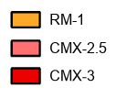
CURRENT ZONING

Slide 29
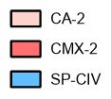
PROPOSED ZONING
Remap schools and city facilities to appropriate zoning
Remap properties to align with desired height requirements
Corrective remappings to align with community vision

